Slide 1

Sub-packages

Slide 2
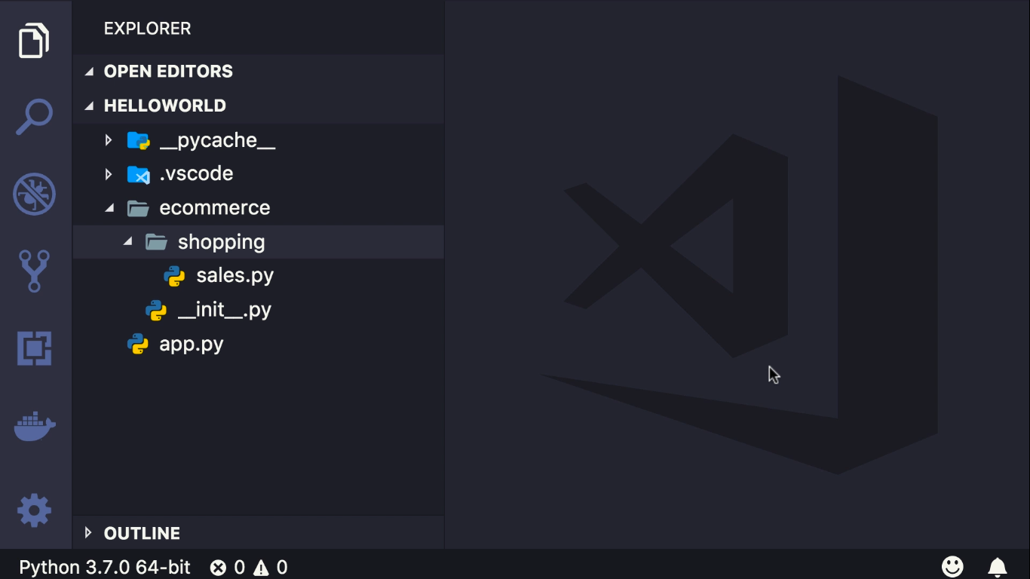

Slide 3
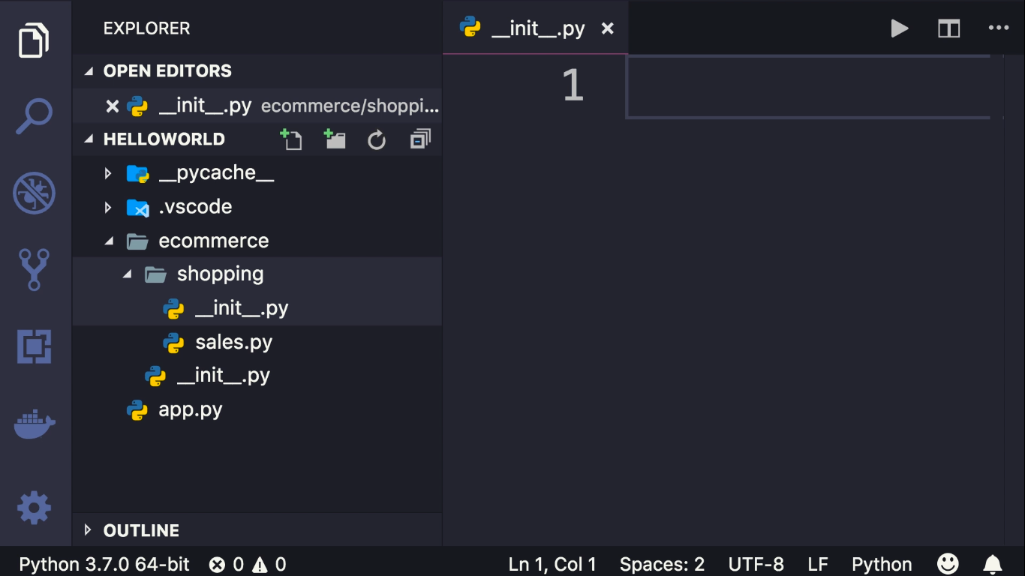

Slide 4
